Slide 1

United Nations Conference on Trade and Development
Tunis
20 June 2003
Electronic Commerce Strategies for Development
A perspective from Absa Bank
Presented by: Alfie Naidoo

Slide 2

Contents of the presentation
Absa in context
Results of Absa’s e-Commerce strategies
Enabling e-Commerce in Africa

Slide 3
The Absa Group
Historical overview
The Absa Group is the product of two major mergers in the early 1990’s
United
+
Amalgamated Banks of South Africa
Bankorp
Trustbank
Senbank
Bankfin
Allied
=
+
=
+
Volkskas
April 1991
April 1992
Notes:
An integral part of the economic fabric of SA
Largest Retail Bank in South Africa
Represented in 11 countries worldwide
$33 billion assets
30,000 employees
One of the top 10 brands in South Africa
Invested $5 million in social upliftment since 1994
1 in 3 consumers obtain a home loan from Absa

Slide 4
Group activities
Retail banking
Commercial banking
Corporate & Merchant banking
International Operations
Africa Banking Operations
Life Insurance
Short-term insurance
Insurance Broking
Trust & investment services
Employee benefits
Absa Bank
Absa Financial Services
Other Activities
Asset management
Property development
Pension payments

Slide 5




Customers
Largest customer base in SA (5,5 m)
Corporate market
2,183 customers
Affluent market
291,473 customers
Middle market
3,870,829 customers
Business market
431,174 customers
Mass market
816,100 customers
Corporate
Individual

Slide 6
Contents of the presentation
Absa in context
Results of Absa’s e-Commerce strategies
Enabling e-Commerce in Africa

Slide 7
A comprehensive distribution footprint
OUTLETS
623
ATM
3,700
INTERNET
400,000
customers
CUSTOMER
CELL PHONE
13,000
customers
TELEPHONE
350,000
customers

Slide 8
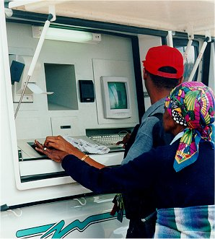
Reaching our markets through integrated delivery
ALLPAY
Biometrically enabled
Human assistance
Expansion to include other banking services

Slide 9
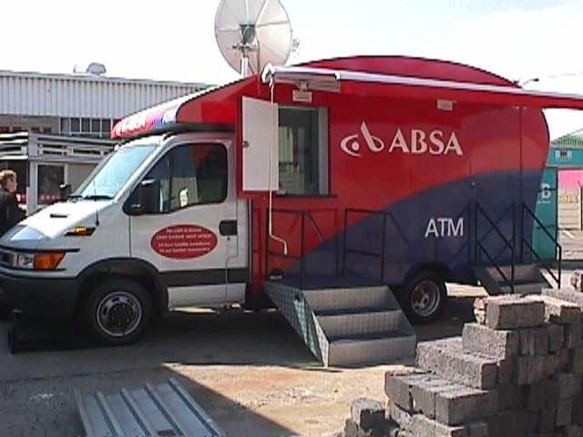
Reaching our markets through integrated delivery
MOBILE ATM’s
Reaching the under-banked
Flexible reach
Migrating transaction behaviour

Slide 10
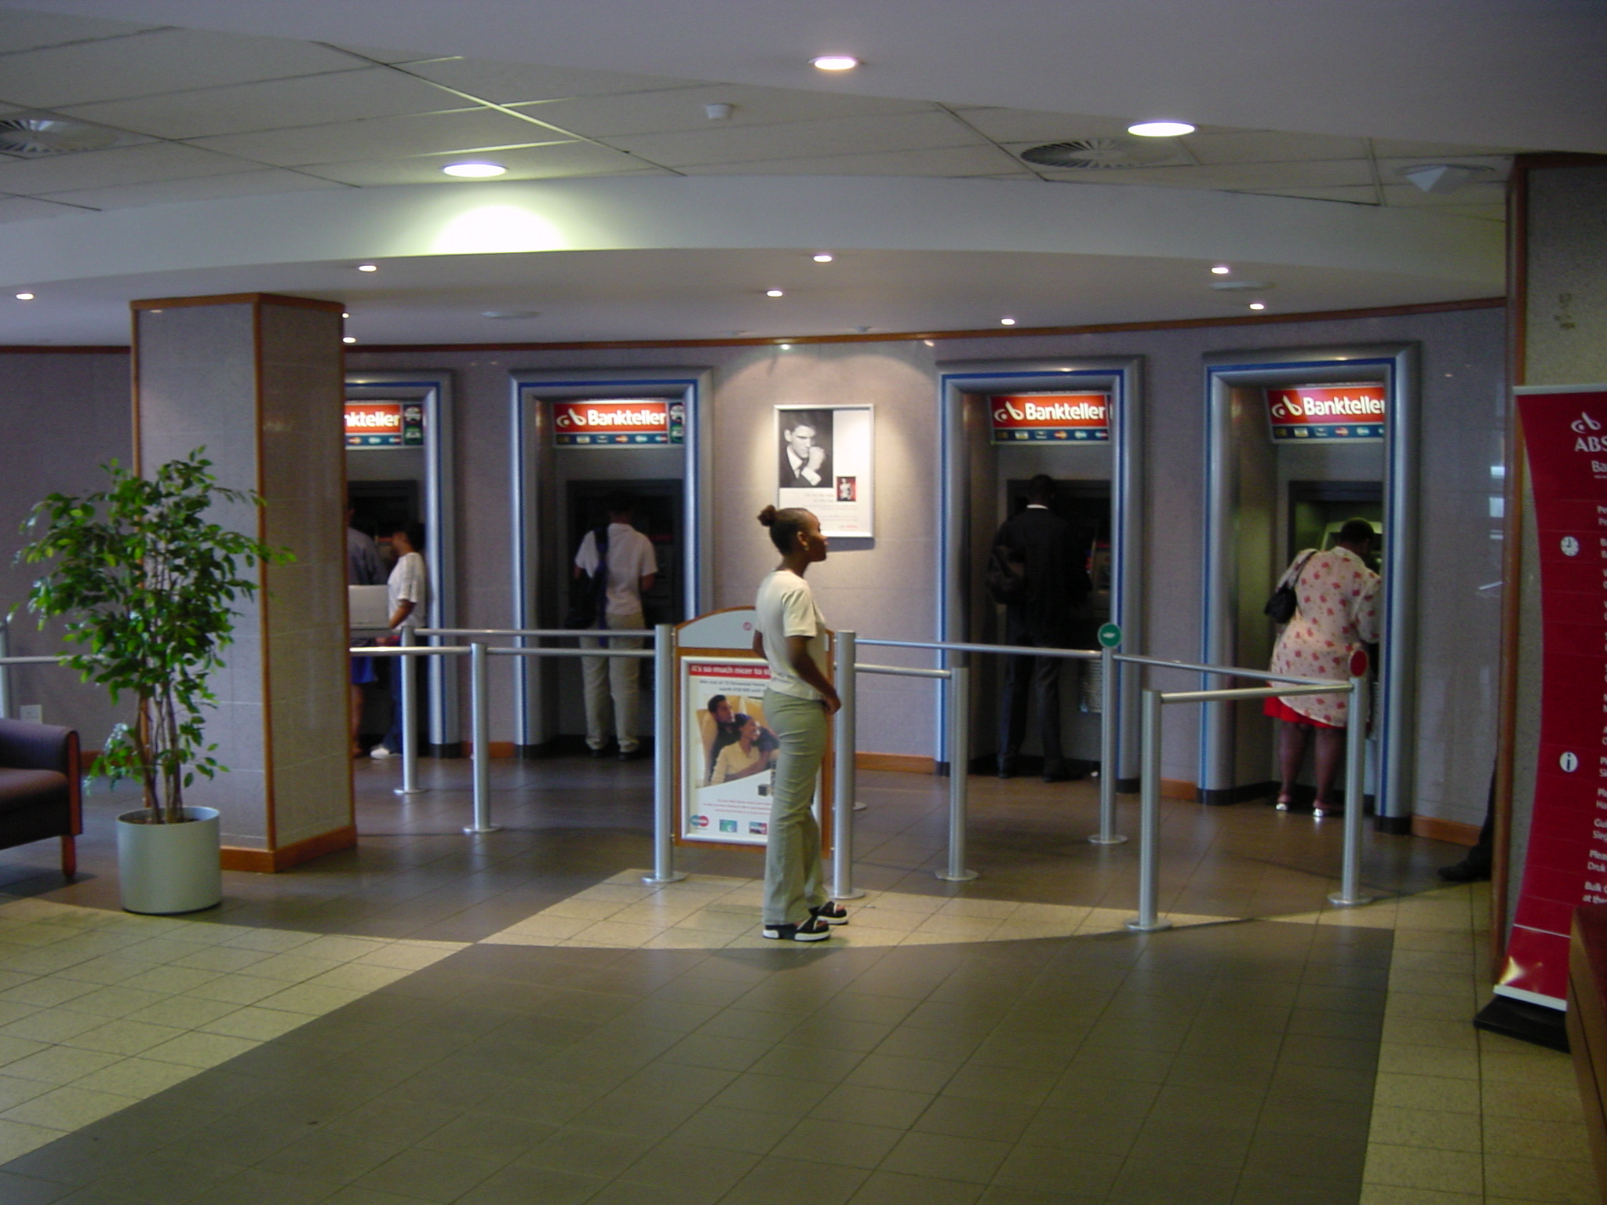
Reaching our markets through integrated delivery
SELF SERVICE CENTRES
Human assistance
Bridging the digital divide through education
Community involvement

Slide 11
Contents of the presentation
Absa in context
Results of Absa’s e-Commerce strategies
Enabling e-Commerce in Africa

Slide 12
Critical Success Factors (CSFs)
Trusted commerce communities
Active participation and protection
Socio economic climate
Education
Market segmentation
Cost effective accessibility
Governance
Resources and funding
Notes:
NOTES:
These are some key issues that will determine the success of e-Commerce.
Trusted Commerce Communities:
Integrity – Trust between trading partners develops over a period of time.
Contributing factors:
Cost
Infrastructure
Readiness
Process changes
Skills
E-readiness
Culture
Active Participation and Protection:
Critical mass to ensure cost effectiveness
Process duplication for non-participants
Protect against unscrupulous business initiators, Crime, Data integrity, Trusted Service Providers.
Socio Economic Climate:
Readiness of specific market segments
Traditions
Access to technology
Education:
Use of technology
Financial skills
Market Segmentation:
Understand specific market needs
Diversity
Skills levels
Channel relevancy
Cost Effective Accessibility:
Needs to be cost effective to be deployed to all communities and not selected few
Channel selection, integration, acceptance and relevance
Migration strategies
Governance:
Universal rules – govern all aspects and all participants
Flexibility – to cater for all applications, communities and market places
Market specific – understand specific markets and dimensions
Entry – criteria to be specific albeit not restrictive
Resources and Funding:
Identify sponsors and service providers
United Nations to contribute
G8 countries to assist
Self funding initiatives
Long-term returns vs short-term returns on investments
Profit from transacting and usage rather than building infrastructure

Slide 13

Commerce as we know it
Buyer
Supplier
Business
Business
Trade
Banking
Clearing
Bank A
Bank B
Settlement
Notes:
Three main areas:
Business:
Internal Processes: Human Resources, Debtor & Creditor Management, Reconciliation, Cash Flows
Trade:
Interactions: Quotation, Ordering, Invoicing, Payment, Delivery, Identification
Banking:
Payment streams, Settlement, Clearing, Transaction Information, Identification, Authentication
Delivery mechanisms:
In Commerce were manual processes are used to enable Business processes.
Settlement and clearing were done by exchanging paper schedules and cheques. In some countries this is still used to clear and settle ie Namibia.
Internal business processes were paper based including cash management, Debtor and Creditor management, etc.
Trade is mainly done with Cash and bartering.
No difference to Commerce but for “e”
Commerce been in place for centuries however, e-Commerce only started 20 to 30 years ago!!!!!!
Automation process:
Office automation started in the ’70’s with emergence of the computer age. The main focus areas during this period was to automate internal processes.
Banking:
The banking industry took the lead in automation and e-enablement. In the early ’70’s, BankServ – the clearing and settlement house in South Africa – automated cheque (MICR) and EFT processes for clearing and settlement.
EFT Volumes (BankServ): Debits = 19 000 000 Trans & R20 000 000 000.00 per month
Credits = 15 000 000 Trans & R147 000 000 000.00 per month
ATM Volumes (BankServ): 13 000 000 Trans & R2 800 000 000.00 per month
Cheques (BankServ): 12 000 000 Trans & R117 000 000 000.00 per month
Business:
Internal business processes were the first to be automated. HR, Cash Management, DT and CT Management, etc were focus areas.
Banking and Business realised that due to inter dependencies it would make business sense to automate processes and interfaces between each other. Business became more and more dependant on electronic information and integration with Banking services. The need for timeous information became the drive to ensure competitiveness.
Today e-Business and e-Banking are fully integrated in South Africa as in most developed countries. We are very sophisticated in most areas of banking and provide a broad spectrum of services via all available channels. (Physical, ATM, Telephone, Contact Center, Mobile, WEB, Dial-up, Host-to Host). Depending on the market segment we provide end to end processes that can be fully integrated with e-Business processes. In some areas we also provide e-Business services as an Application Service Provider (ASP).
In Africa, Absa provides not only banking services but we also had to establish an infrastructure to be able to provide these services.
Trade:
There was no focus on e-Trade in the seventies and most of the ’80s. In the ’90’s this however changed and the need to automate trade processes became apparent.

Slide 14


B2B, B2C and C2C e-Commerce
Business
B2B
Business
e-Business
e-Business
e-Trade
Consumer
B2C
Consumer
e-Banking
Clearing
Bank A
Bank B
BankServ
Settlement
Notes:
Identify three “Communities””
B2B
B2C
C2C
Focus on B2B and B2C
Difference between B2C and B2B only lies in the transaction volume, sophistication of technology and infrastructure used. Basic process the same in TRADE, BUSINESS and BANKING.
Needs are the same:
Cost effectiveness
Access
Trust
Reliability
Challenges are the same:
Readiness
Size of community/market segment
Historical/cultural dynamics
B2B:
Depending on the business segment, e-enablement and integration between Banking and Business is comprehensive.
Corporate: Sophisticated, fully integrated, Multi Channel – mainly direct (Host-to Host). High demand for enhancements, process speed, functionality, domestic and international solutions and security.
Large and Medium Business: Demands and needs are the same with only the volumes and channel utilisation models being different.
SME: Becoming more and more sophisticated. Area of highest growth. Connectivity mainly WEB, Mobile and Telephone.
B2C
Retail: The biggest difference is evident in the retail market. Income, educations, tradition, etc. is evident in the utilisation of e-channels and services. On the one end of the scale the A and B income groups are fully utilising e-Channels and services whereas on the other hand the emerging markets are mainly using cash and slowly increasing the use of card type interfaces – POS and ATM.
The retail market’s e-Banking utilisation is one of the biggest challenges facing the financial services industry. Together with B2B e-Trade are the areas that requires focus and investment.

Slide 15
e-Banking CSFs
e-Banking:
Infrastructure
Cost effectiveness
Market segmentation
Multi channel delivery
Payment streams
Risk management
e-Trade
e-Business
e-Business
e-Banking
Clearing
Bank A
Bank B
BankServ
Settlement
Notes:
e-Banking has had the most success in e-Commerce. Mainly due to internal process automation.
Not all banks or Countries have requirements to enable e-Commerce
There are no clear strategies as to where and how banks should be involved as service providers in the e-Business and e-Trade environments. The more banks get involved in non-banking solutions the further we move away from traditional banking. That in itself might not be negative however, e-Trade remains an area that is not fully defined or understood. Roles and responsibilities in addition to infrastructure and the migration from trade to e-trade requires more clarification and insight. This is specifically true in the “un-banked” and “un-skilled” market segments.
Multi Channel deliver does not always mean that a migration will take place from the on to the other. This rather refers to the availability of multi channels. The channels will be used by different market segments on different occasions. Some of the channels will be used as an alternative rather than as a replacement.
The various payment streams with their specific risks and dynamics add to the complexity. We need to differentiate between the various and defined risks between the payment streams as well as separating E-Commerce risks from Trade risks, Banking risks and Business risks.

Slide 16

B2B CSFs
e-Trade
e-Business
e-Business
e-Banking
e-Business:
Internal processes
Infrastructure
Cost effectiveness
Market segmentation
Change Management
Clearing
Bank A
Bank B
Settlement
Notes:
Internal process automation and link to e-Banking “Fast Tracked” e-Business development.
Process and cost effectiveness were drivers to automate production and administration processes
Internal Processes: This was the focus with the emergence of computerised systems. HR, Stock Control, Cash Management, Debtor & Creditor Management, etc were the first to be automated. Some of the services available are highly sophisticated and costly. The dependency on single “vendors” has caused some companies dearly.
Infrastructure: Due to the availability of sophisticated software systems, internal business infrastructures had to be upgraded to match the demands of automation. The fast pace of software and hardware development combined with a changing business environment, means that companies needs to be on their toes to keep up with the competition. The focus therefore could not be to establish e-Trade but to focus on e-Business.
The responsibility and resources to establish and fund e-Trade remains an area of concern.
Cost effectiveness: Not all changes are cost effective. The cost to upgrade Internal Processes and Infrastructure is high. The return on investment has to be justified over longer periods and the benefits are not always realised within the estimated time frames.
Market Segmentation: The market segment to whom a business belongs is a contributing factor as to the level of e-Business advancement. The second segment is the target market segment of the business. The sophistication of both these determines the level of e-Business enablement.
Change Management: Although not always quantifiable, there is a substantial cost implication in addition to the time it takes to change behaviour and processes. The need and will to change as well as the level of complexity are all contributing factors.

Slide 17
B2C CSFs
Consumer
e-Trade
Business
e-Business
e-Business
“e-Individual”:
Tradition
Trust
Sophistication
Socio economic impact
Cost effectiveness
Access to technology
Convenience
e-Banking
Clearing
Bank A
Bank B
Settlement
Notes:
Enabling e-Commerce to the individual are more complex due to the diverse market segmentations. Even in “developed” countries some market segments are not e-enabled.
In Africa the divide is even more apparent.
Tradition: The traditions in South Africa and in Africa are well established over centuries. The way to conduct business is well entrenched in these traditions and customs. Bartering, the ceremonial exchange of payment, the type of payment (live-stock, goods) and environment (remoteness) are aspects that requires consideration.
Trust: This is maybe one of the biggest hurdles. Due to a number of reasons trust is a slow process that requires dedication, a will to change, education, resources, etc.
Sophistication: Apart from the level of sophistication to enable e-Commerce, the need for e-Trade in some communities are not realised or defined. Education, access to technology, cost of transacting and effectiveness are but a few of the underlying factors that determine the level of sophistication.
Socio Economic Impact: We need to understand the impact of the current socio economic status and the need to improve or change current statuses. Socio economic upliftment and education are pre-requisites to ensure an environment to facilitate change.
Cost effectiveness: Cost effectiveness has been used to justify most of the e-enablement initiatives. We need to understand the components of e-enablement before we can validate cost effectiveness. There are a number of areas that needs to be taken into consideration. Transaction cost for the individual can not be seen as a justification for e-enablement. The individual need to have an existing e-infrastructure before they can initiate a transaction. This is where the next point comes into play – Access to Technology.
Access to Technology: The individual must have access to technology before we can expect them to partake in e-commerce. The appropriate technology for the relevant market segment and application are relevant components that requires attention. Cost of providing the technology becomes apparent if we understand the socio economic status of specific target markets.
Convenience: Convenience and access should be combined to address all aspects of the “e-individual”. What might be convenient for business might not be convenient to the individual. Remoteness of target markets, transport infrastructure, cost effectiveness, access, sophistication and tradition are again not individual components but should be seen holistically.

Slide 18
e-Trade CSFs
Buyer
Supplier
e-Business
e-Business
e-Trade
e-Banking
e-Trade:
e-Communities
Infrastructure
Cost effectiveness
Market segmentation
Legacy
Convenience
Change Management
Clearing
Bank A
Bank B
Settlement
Notes:
Community participation is one of the biggest challenges to enable e-Trade. Within the established Commerce environment these communities developed over decades. The processes and delivery mechanisms were adapted to suite the environment. The fact that we still trade with consumables (Physical goods) and not only services (Non-Physical) complicates the e-enablement. Cost of infrastructure and participation to establish viable communities are current inhibitors for a swift transition to e-Trade in the B2B environment.
In the B2C environment the same factors are present however, trust, education and traditions are more prevalent.
Cost and change management are focus areas. Duplicating infrastructure vs “severing” business relationships are two conflicting “choices”. Here market segmentation and diversification are the main contributors to slow down e-enablement. This is true not only in the B2B environment but also the B2C market.
Global e-Trade becomes even more of a challenge in lieu of differences between 1st and 3rd world countries. In some 1st world countries the use of technology in the B2C market and in some B2B segments are not prolific either. The goods being used in trade complicate the environment further.
Change management to migrate from one delivery mechanism to another is a process with its own challenges.

Slide 19
The Total Commitment
e-Commerce
Trusted Communities
Education & Development
Resource & Fund
Participation & Protection
Cost Effective Access
Socio Economic Climate
Market Segmentation
Governance
Tradition and Trust
Willingness to Change
Notes:
NOTES:
Absa believes that we should consider all aspects to enable e-Commerce
Governance together with Resources and Funding are the first two pillars of commitment that is required to support e-Commerce in Africa. These should not only be used to provide an infrastructure for e-Commerce but should simultaneously focus on the rest of the structures (Pillars) that are required to support e-Commerce.
These are:
Trusted communities are required. These communities will take time and resources to be fully operational.
Participation and protection. It is required that the target markets actively participate within these communities with the knowledge and assurance that the rights are protected within the governance structures.
Socio Economic Climate. It is paramount that we understand the socio economic dynamics that are present in the specific target markets. We should understand that the various segments have diverse needs and requirements depending on skills and access. This must also be seen within the level of readiness of a specific target group or society.
Education and Development will form a basis and should therefore be the point of departure within specific social groupings and environment. Exposure to technology does not in itself build trust. Trust is “earned” by experience, knowledge and convenience.
Market Segmentation. It is critical that we define and understand the different market segments and sub-segments. Culture, experience and skills plays an important role when defining market segments. The needs and requirements should be real to the target market and not perceived by the “inventors”. Solutions should cater and provide for diversity and flexibility. It should be sophisticated but yet user friendly to the specific target group.
Cost effectiveness. It goes without saying that the proposed solutions should be cost effective for the specific target market and not necessary to the service provider. Nobody will migrate to a alternative delivery mechanisms or service without considering costs.
There is a willingness to change however, Africa needs to understand that this willingness is still imbedded in traditions and trust. We should consider this when we embark on initiatives to:
Encourage and Facilitate Economic Growth
Encourage and Facilitate Development
Establish and Provide Infrastructures
Embark on training initiatives
Ensure and enable capital flows
Facilitate market access
Consider and understand all environments
When we talk of e-Commerce, we need to understand the intricacies and dynamics of the market place. If we look at Europe and the single currency (Euro) and the difficulties associated with the implementation (in a well defined marketplace), we can understand that if we want to implement a “single” e-Commerce environment in a relatively new marketplace, it will have defined and un-defined challenges.

Slide 20

THANK YOU

